Slide 1

Get Hired
Presented By: Harshada Bagal(002913267)
Sudharsan Ragavendhiran Anuradha(002783355)
Swarali Patil (002697717)
Anupam Aditya (002920714)

Slide 2
About GetHired
The GetHired initiative is a comprehensive web-based platform designed for university students to facilitate their job search and career management needs.
It serves as a one-stop-shop for all their employment-related requirements.

Slide 3

Tech Stack
(MERN STACK)
DB : Mongo DB(Connected to MongoDB Atlas)
Front End : ReactJS, Redux, HTML, SCSS
Back End : (Rest API's)Node(Express JS), Token : (JWT)

Slide 4
Features
Recruiters and Student can login using their valid credentials. Credentials are validated using JWT authentication.
Students can create their profile and add documents such as resume.
All documents are uploaded and maintained on Amazon S3
Recruiters of companies post job openings that students can view and apply for. Career Fairs, Networking and Speaker events are posted on the portal and available for student booking
Recruiters can view the applications and download the student's resumes.

Slide 5
Used Google maps to display location of the event
Students can filter on available jobs and events to find ones that interest them.
Students can search for a job
Students can post reviews about organizations for other students to peruse
Students can access their dashboards to view their applications, registered events and job recommendations based on their interests.
Used Charts.js to display the status of the applications on the student dashboard.

Slide 6
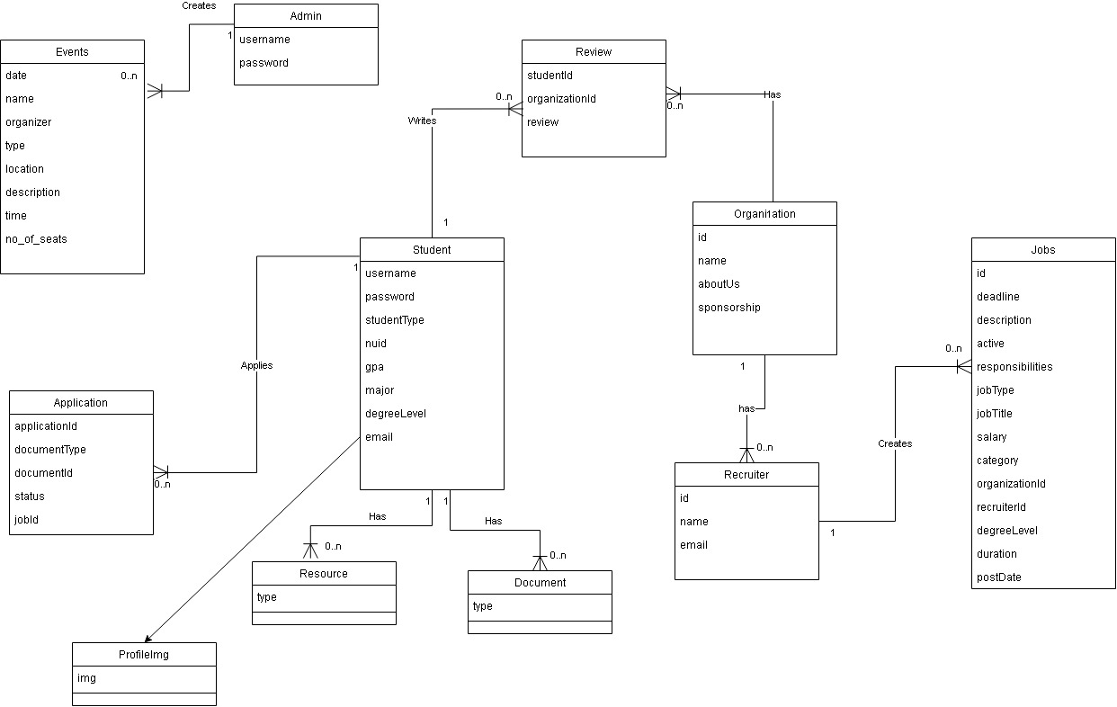
Domain Model

Slide 7
Contributions Made:
Swarali Patil
Design of UI, Sign in, Sign out, header, landing pages, SCSS, Javascript
Backend – Application
Sudharsan Ragavendhiran Anuradha
Design of UI, Designing Dashboard, Dash-Header and pop-ups pages, Javascript, SCSS
Backend – Organization, Job
Harshada Bagal
React , Model , Helpers Designing, MongoDB , Validations
Backend – Project , Registration
Anupam Aditya
Redux implementation, Routes, Utilities, MongoDB
Backend – Student, Recruiter

Slide 8
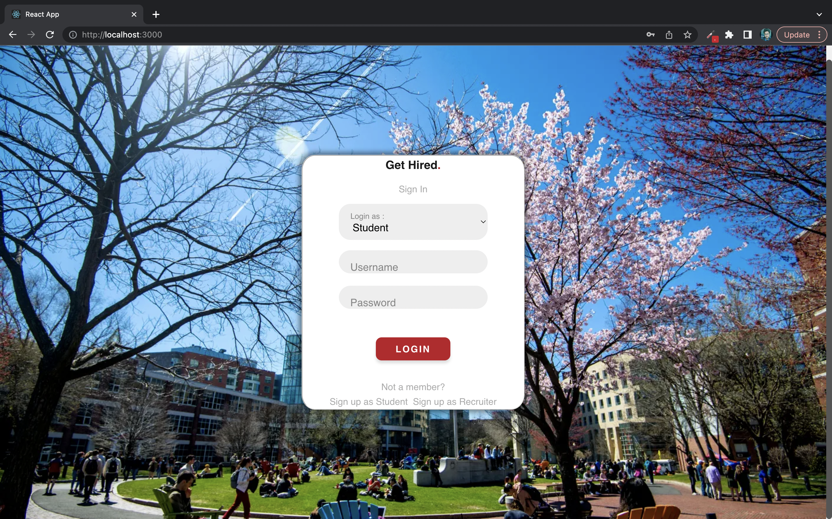
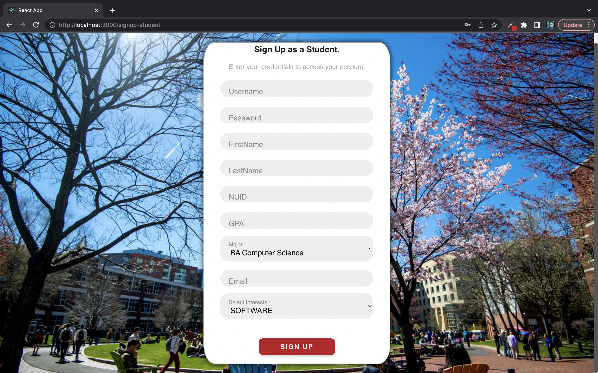
Screenshots

Slide 9
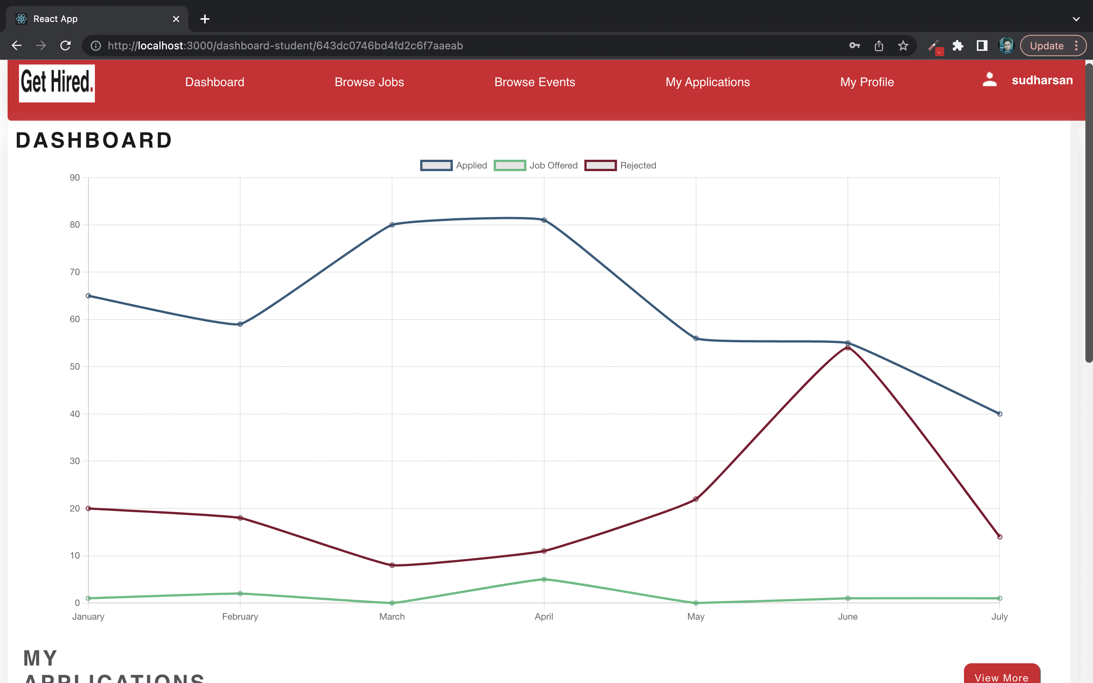

Slide 10
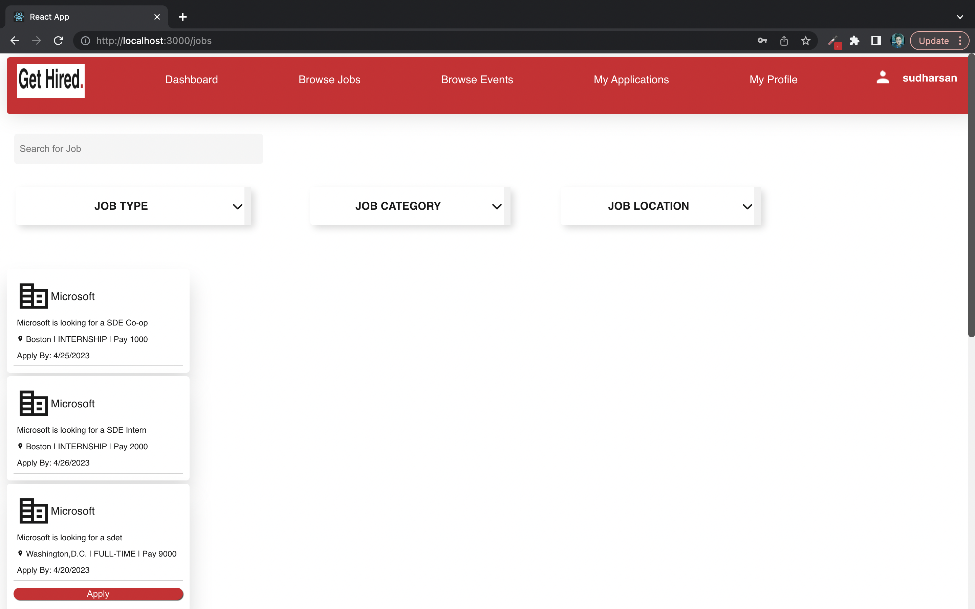

Slide 11
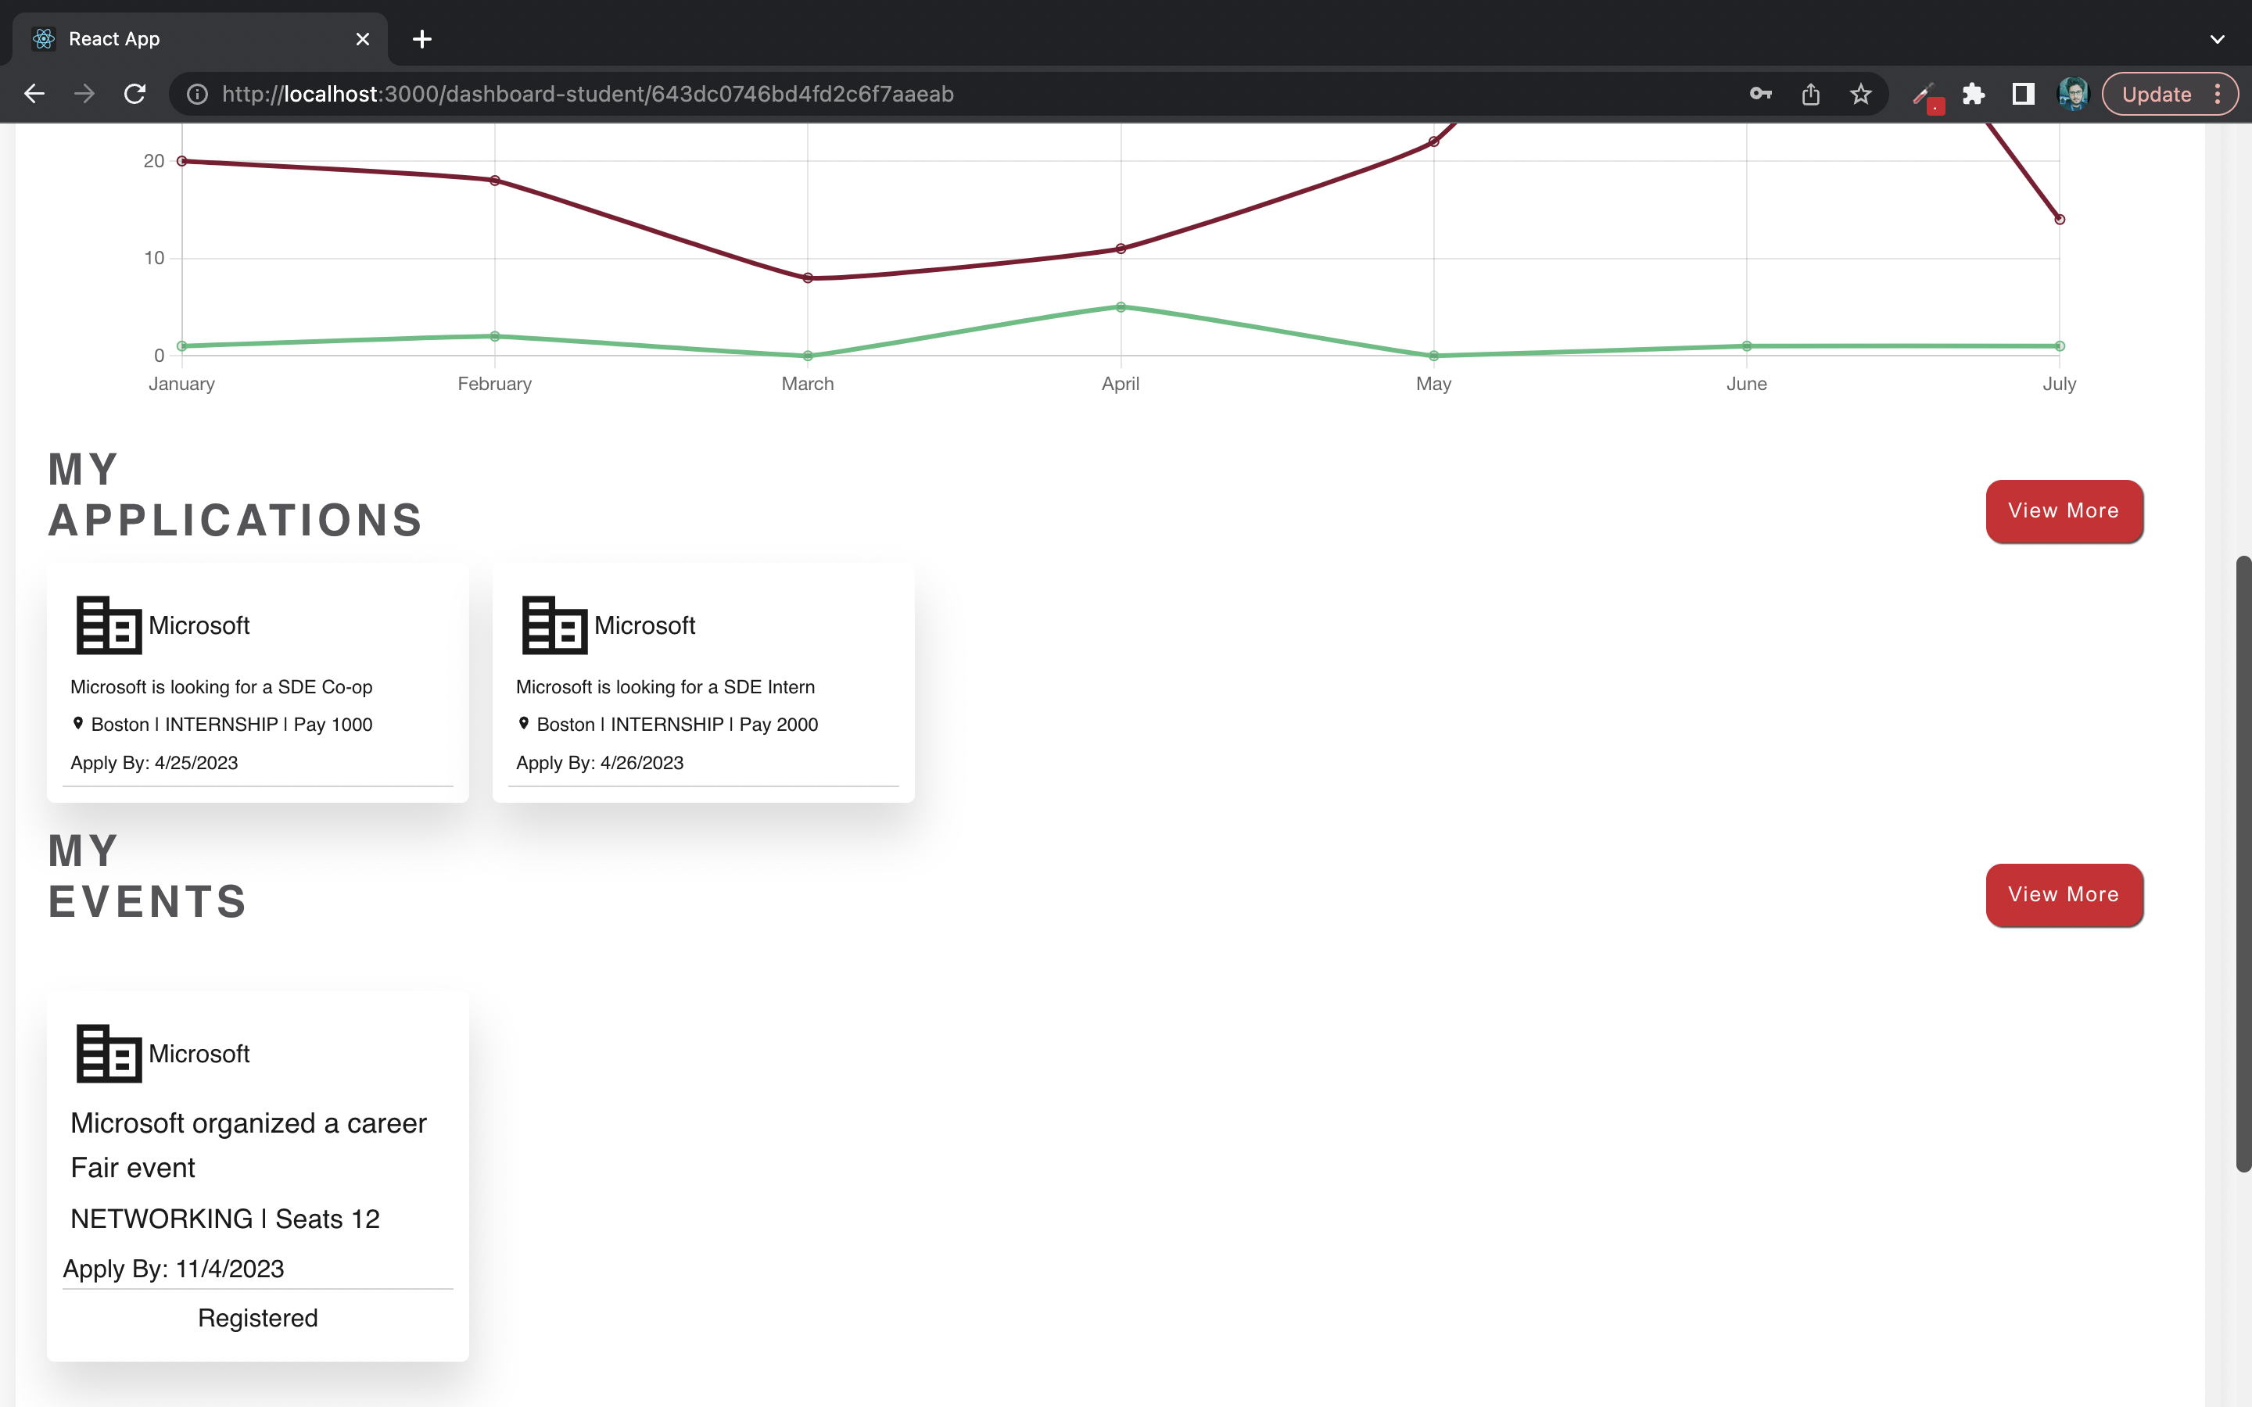

Slide 12
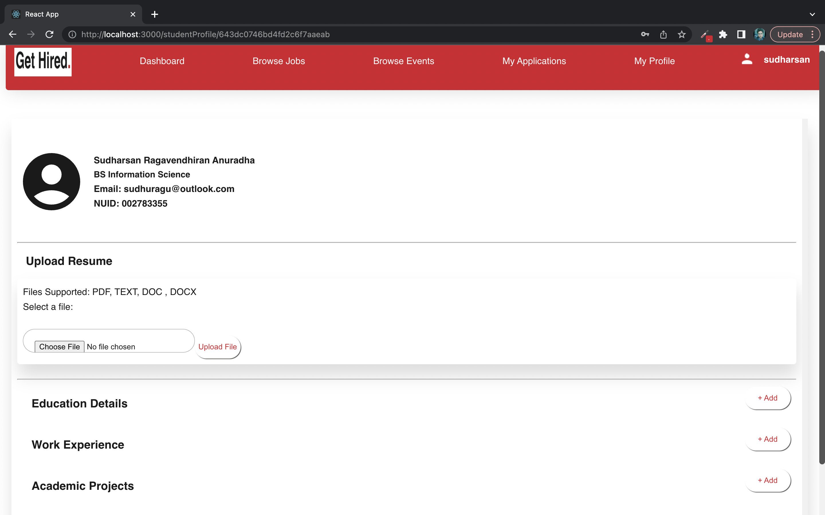

Slide 13
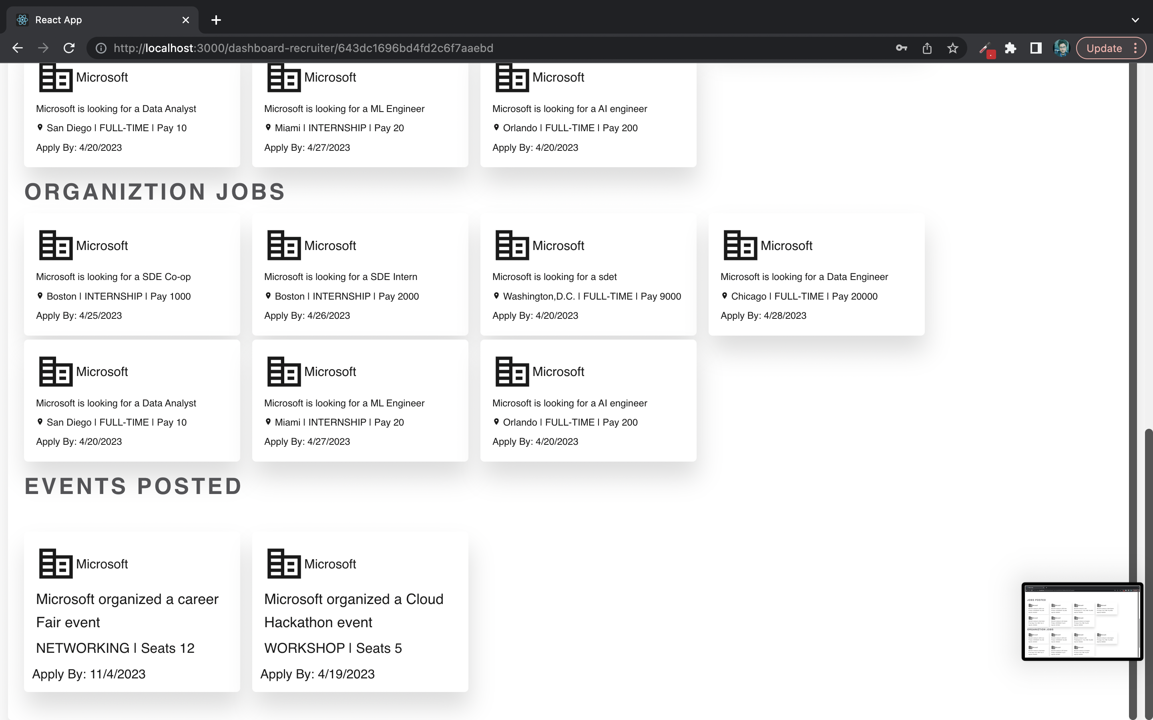

Slide 14
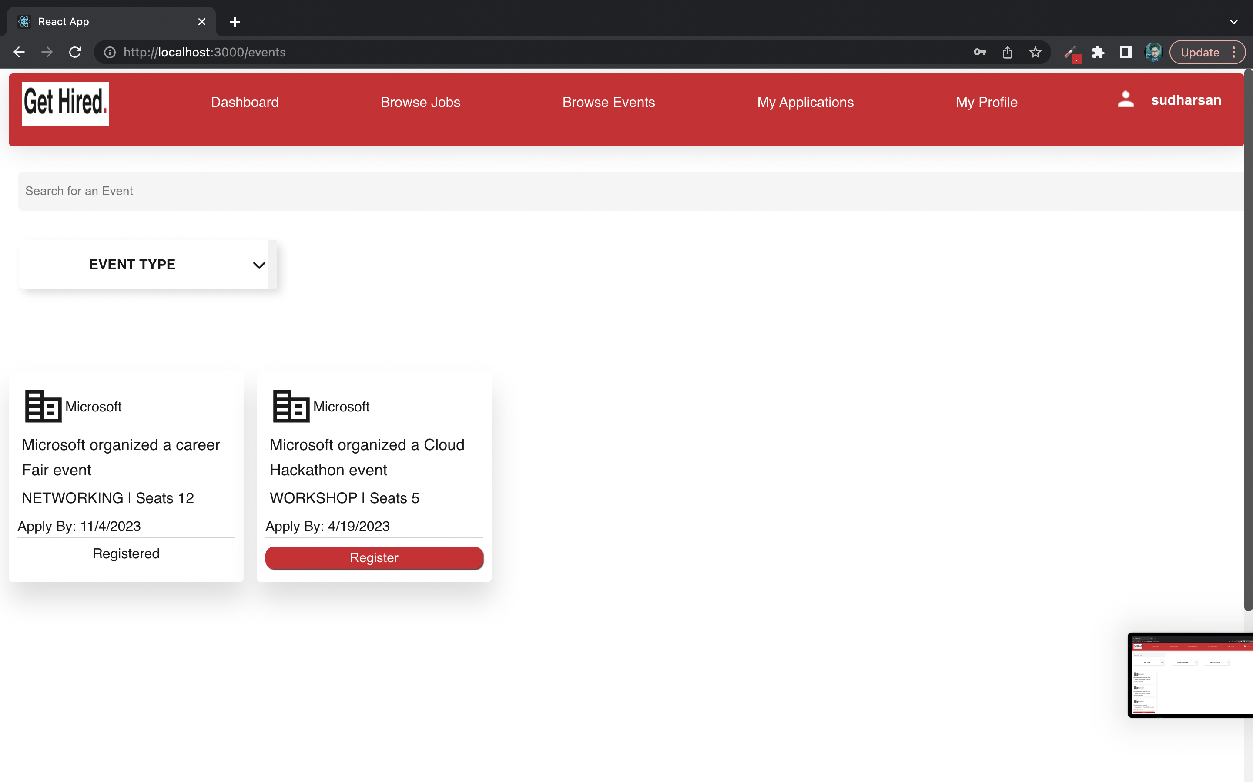

Slide 15


